Slide 1
CUSTOMER SENTIMENT ANALYSIS
TASK 1
COTTON CLOTH OF CUSTOMER SENTIMENT ANALYSIS

Slide 2
INTRODUCTION
Cotton cloth is one of the most widely used natural fabrics in the world, known for its softness, breathability, and durability.
It is made from cotton fibers, which are spun into yarn and woven or knitted into fabric.
Cotton is popular in clothing, home textiles, and industrial applications due to its comfort, versatility, and ease of maintenance.

Slide 3
Customer Sentiment Review
Customer sentiment analysis helps understand how consumers feel about cotton cloth products by categorizing feedback into three main types:
Positive sentiment
Negative sentiment
Neutral sentiment

Slide 4

Positive sentiment
Customers who appreciate cotton fabric often highlight its comfort, softness, and durability. Positive reviews may mention benefits such as:
Breathability and skin-friendliness
High absorbency and comfort in different weather conditions
Eco-friendliness and biodegradability

Slide 5

Negative sentiment
Some customers may express dissatisfaction due to issues like:
Shrinking after washing
Wrinkling easily
Color fading over time

Slide 6

Neutral sentiment
Some reviews neither strongly praise nor criticize the product. These reviews often describe:
A balanced experience with both pros and cons
General product observations without strong emotions

Slide 7

Costumes view E-commerce form platform

Slide 8



Slide 9
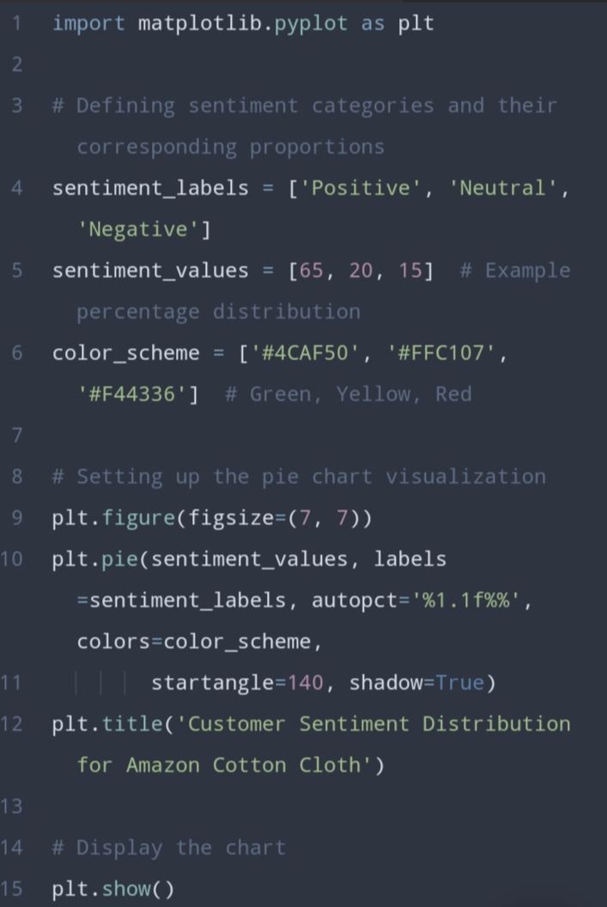
Coding

Slide 10
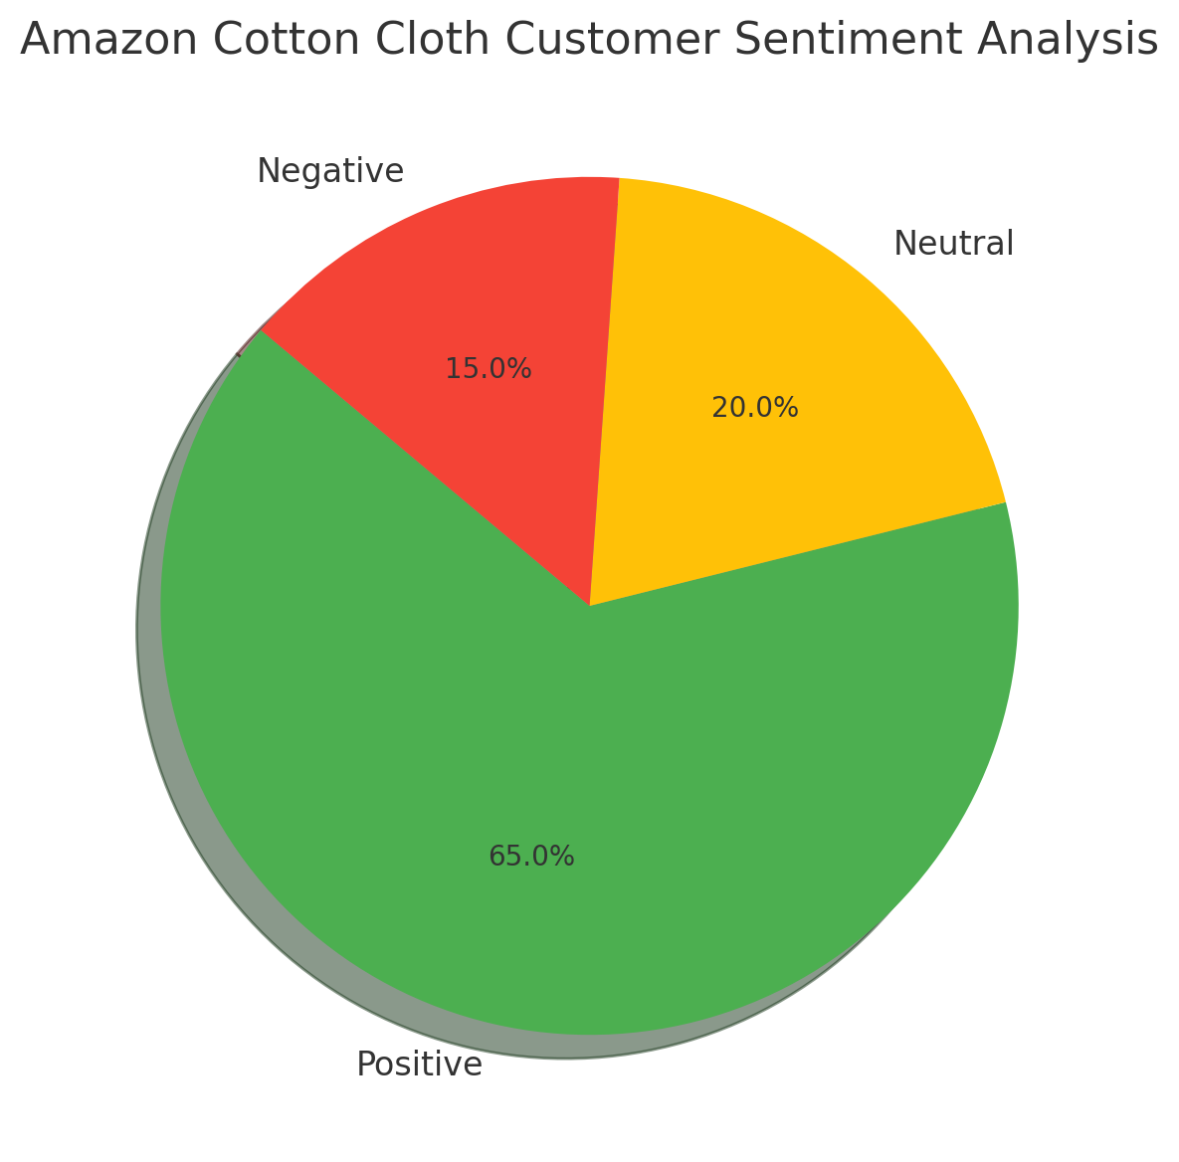
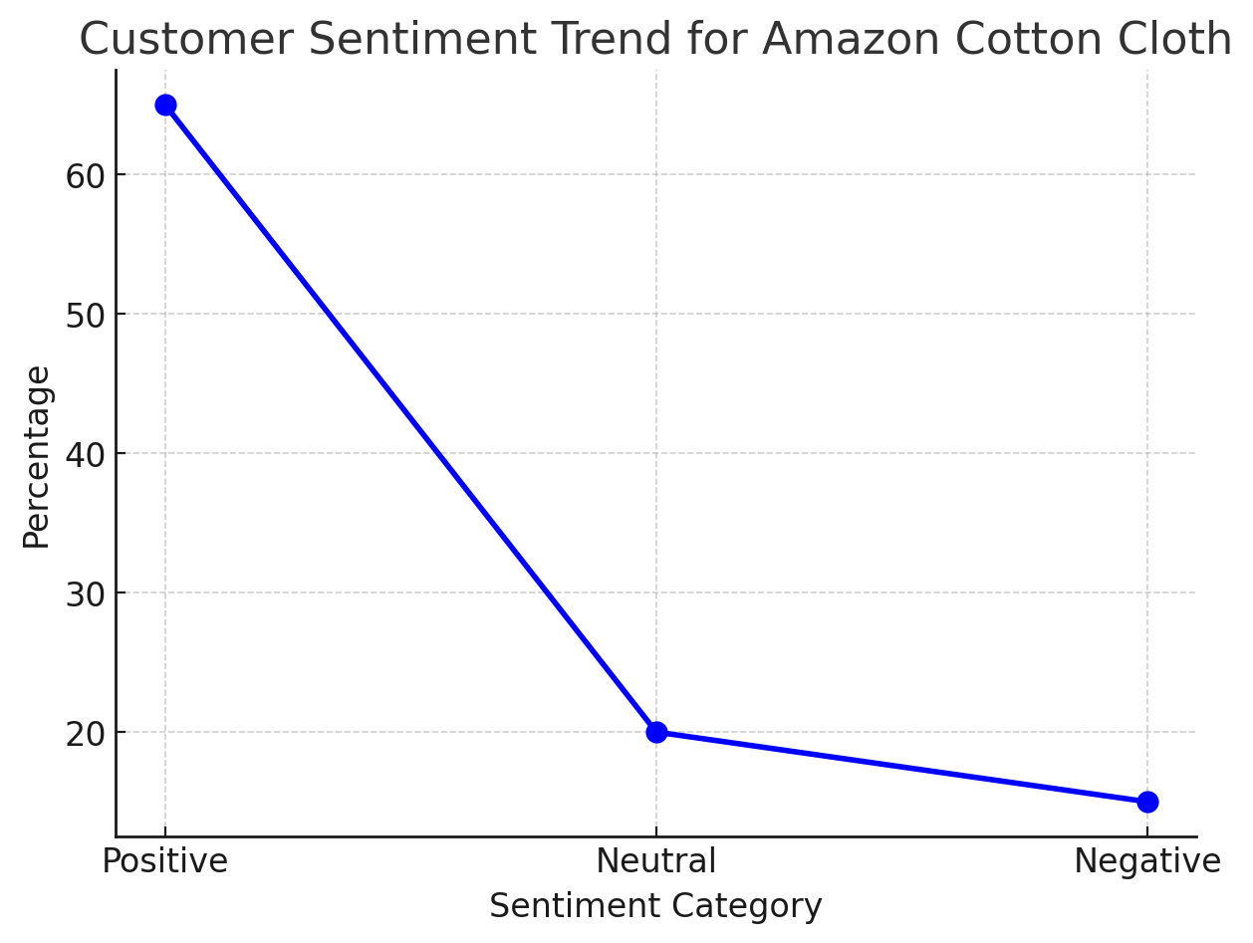
Output

Slide 11
